Slide 1
NAAN MUDHALVAN – DIGITAL MARKETING PROJECT
TITLE – BRAND NAME CREATION
NM TEAM ID – NM2023TMID02164

Slide 2

BRAND NAME : KGF FASHIONS
Brand logo :

Slide 3
CATEGORY :
You can have anythings you want in life if you dree for it.
Emai : info@kgffashion.com

Slide 4


Slide 5


Slide 6


Slide 7


Slide 8
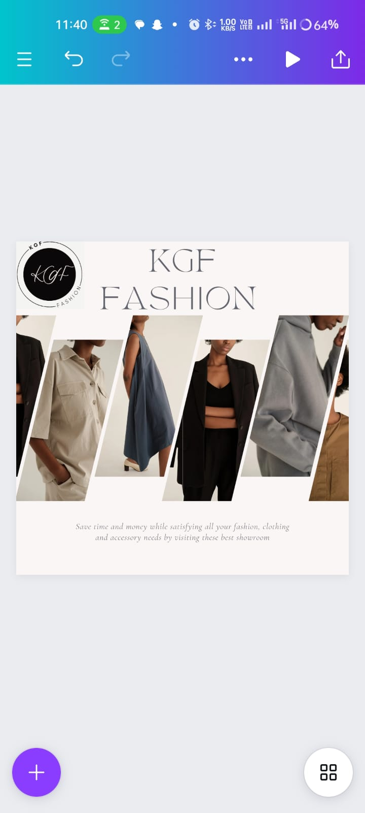

Slide 9


